Slide 1
PDE4433 Session 3
ML-2 Classification

Slide 2
In this lesson … Part 1
PCA
Machine Learning
  Classification
Decision Trees and Random Forest
  Top-down, greedy recursive splitting
Naïve Bayes

Slide 3
In this lesson … Part 1
PCA

Slide 4
Consider the following example
X-Z Projection
X-Y Projection
Original 3D data
Y-Z Projection

Slide 5
Consider the following example
X-Z Projection
X-Y Projection
Original 3D data
Y-Z Projection
Which projection is more representative of the original data?

Slide 6
Principal Component Analysis
Principal Component Analysis, or PCA, is a dimensionality-reduction method that is often used to reduce the dimensionality of large data sets, by transforming a large set of variables into a smaller one that still contains most of the information in the large set.
Goal:
reduce the number of variables of a data set, while preserving as much information as possible.

Slide 7
What does Principal components mean ?
Principal components are new variables that are constructed as linear combinations or mixtures of the initial data variables.
These combinations are done in such a way that the new variables (i.e., principal components) are uncorrelated and most of the information within the initial variables is squeezed or compressed into the first components.
So, the idea is 10-dimensional data gives you 10 principal components, but PCA tries to put maximum possible information in the first component, then maximum remaining information in the second and so on.

Slide 8
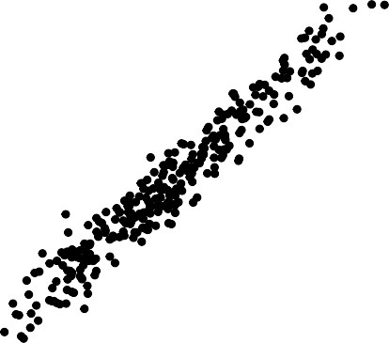
What does Principal components mean ?
Principal components represent the directions of the data that explain a maximal amount of variance, that is to say, the lines that capture most information of the data.
The relationship between variance and information here, is that, the larger the variance carried by a line, the larger the dispersion of the data points along it, and the larger the dispersion along a line, the more the information it has.

Slide 9
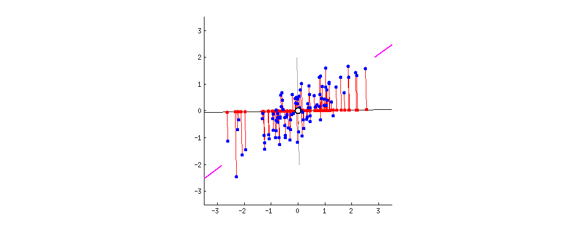

To put all this simply, just think of principal components as new axes that provide the best angle (direction) to see and evaluate the data, so that the differences between the observations are better visible.

Slide 10
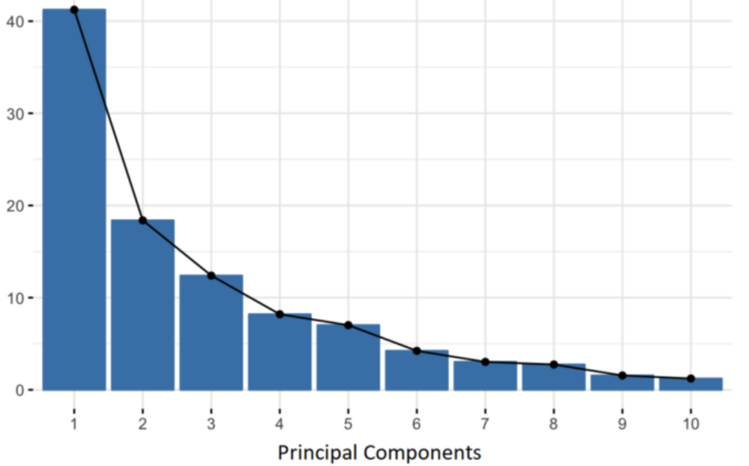
What does Principal components mean ?
Organizing information in principal components this way, will allow you to reduce dimensionality without losing much information, and this by discarding the components with low information and considering the remaining components as your new variables
60%
20%
10%
5%
2%
2%
0.4%
0.3%
0.2%
0.1%

Slide 11
In this lesson … Part 1
Machine Learning
  Classification

Slide 12
Machine Learning
Logistic Regression Decision Trees Random Forest
...
Supervised Learning
Classification Regression
Machine Learning
Tasks
Algorithms
K-means
K-methoids Sting
A-priori
...
Unsupervised Learning
Clustering Association Rules

Slide 13
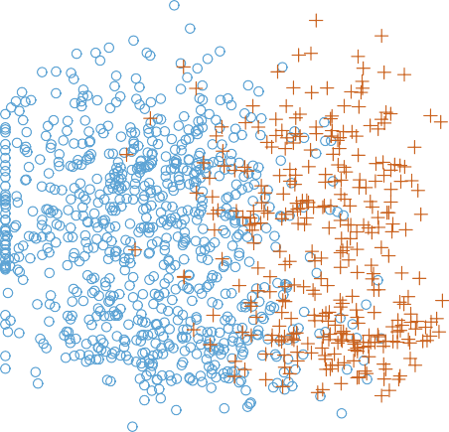
Example of classification
Independent variables:
Size
Color
Dependent variable
Fruit Type
Color
You can see that the response variable is discrete (two values, orange and blue dots in the plot).
Size

Slide 14
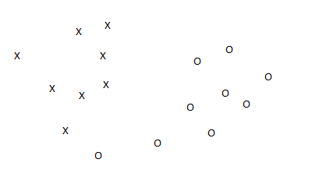
Example of classification
The output is two Classes
Classifier dimension:
  m-1, where m is the data dimension (number of independent variables)
Example: Fruit classification to Bananas and Oranges based on the size and the color
  m = 2 → 2-D
  Classifier is a line → 1-D

Slide 15
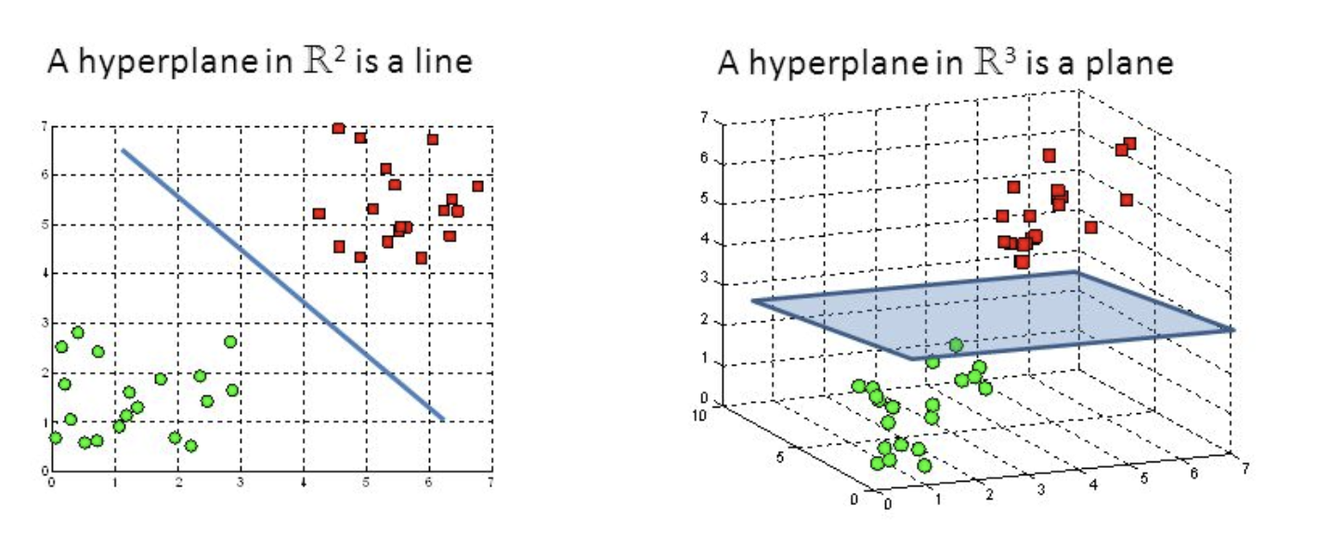
2-D Vs 3-D

Slide 16
The Classifier
How?
The classification algorithm will find the best line to separate the two classes (linear classifier)
Which line in the best line?

Slide 17
The Classifier
Maximum Margin
How?
The classification algorithm will find the best line to separate the two classes (linear classifier)
Which line in the best line?

Slide 18
Classification techniques
k-Nearest neighbor
Decision trees
Support vector machines
Bayesian models
Neural networks

Slide 19
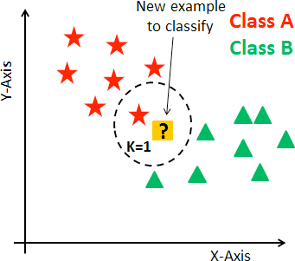
Classification techniques
Non parametric method with works on the assumption of locality, that is nearby points have similar values.
k-Nearest neighbor
Decision trees
Support vector machines
Bayesian models
Neural networks
Dr. Giovanni Quattrone, Middlesex University

Slide 20
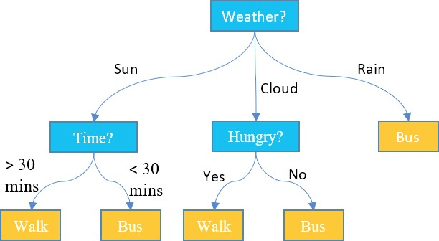
Classification techniques
A decision tree is a decision support tool that uses a tree-like model of decisions.
k-Nearest neighbor
Decision trees and random forests
Support vector machines
Bayesian models
Neural networks
Dr. Giovanni Quattrone, Middlesex University

Slide 21
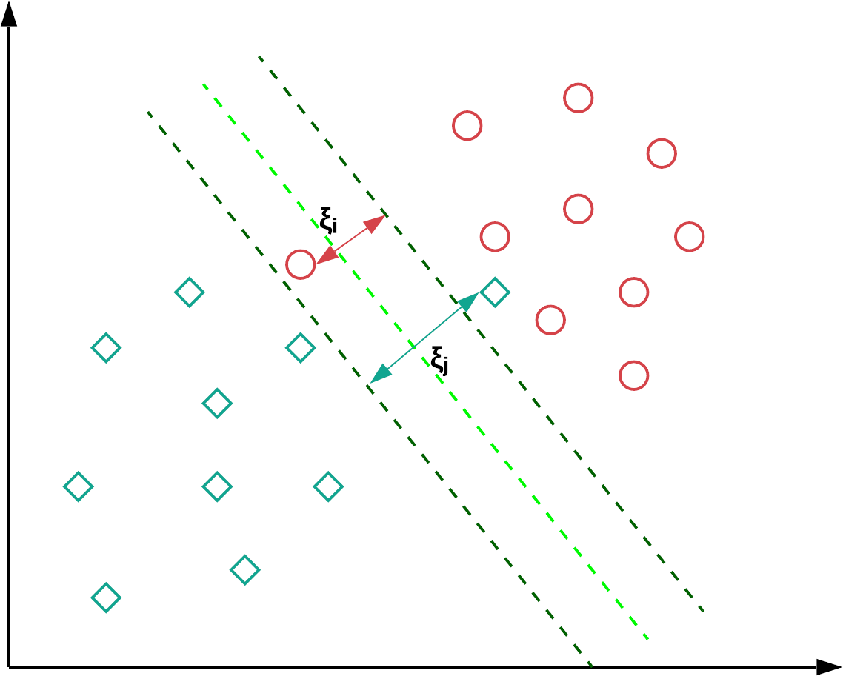
Classification techniques
A Support Vector Machine (SVM) is a classifier formally defined by a separating hyperplane.
k-Nearest neighbor
Decision trees
Support vector machines
Bayesian models
Neural networks
Dr. Giovanni Quattrone, Middlesex University

Slide 22
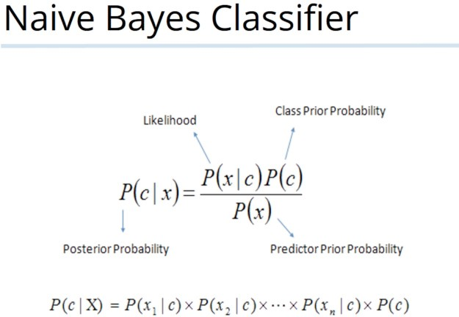
Classification techniques
k-Nearest neighbor
Decision trees
Support vector machines
Bayesian models
Neural networks
A Bayesian model is a statistical model where you use probability to represent all uncertainty within the model.
Dr. Giovanni Quattrone, Middlesex University

Slide 23
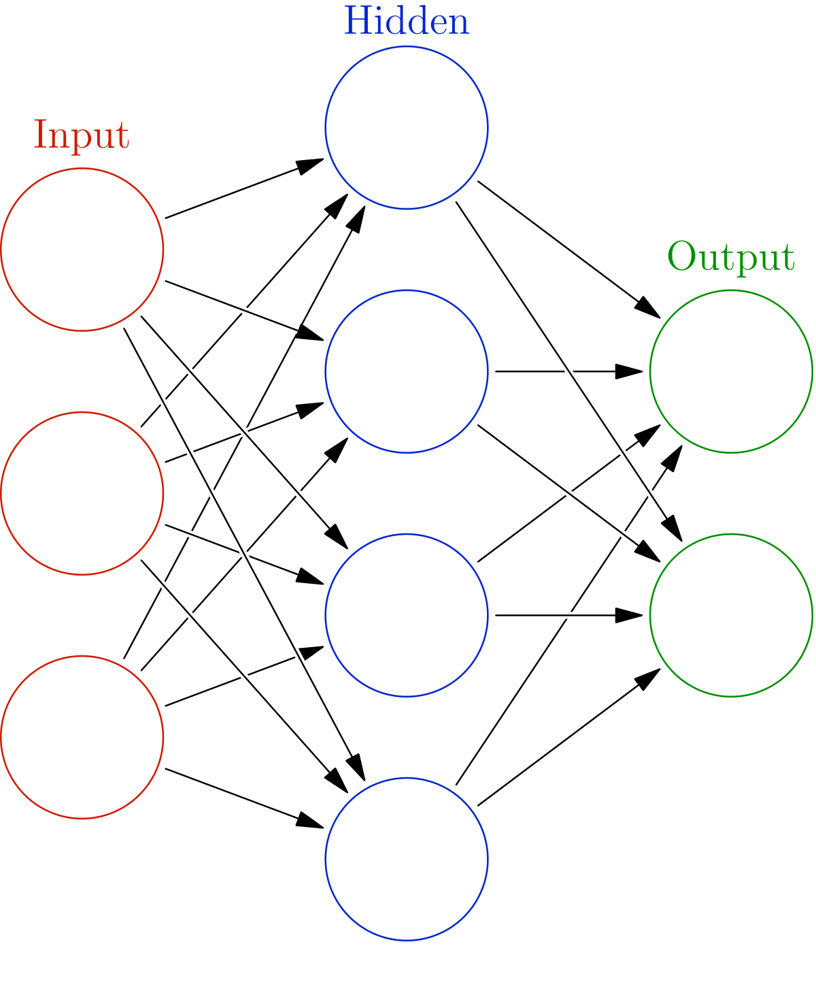
Classification techniques
k-Nearest neighbor
Decision trees
Support vector machines
Bayesian models
Neural networks
Artificial Neural Networks (ANN) are computing systems that are inspired by, but not identical to, biological neural networks that constitute animal brains
.
Dr. Giovanni Quattrone, Middlesex University

Slide 24
In this lesson …
Decision Trees and Random forests

Slide 25
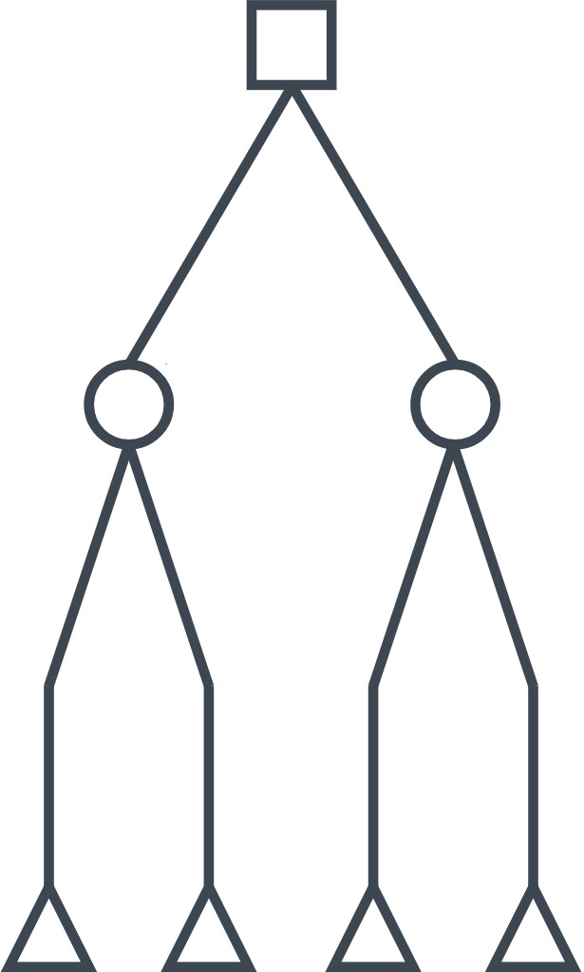
Decision Trees
A decision tree (DT) classifies using a set of hierarchical decisions on the features. The decisions made at internal nodes are the split criterion.
A DT is rooted directed tree.
In DTs, nodes with outgoing edges are the internal nodes. All other nodes are terminal nodes or leaves of the DT.
In DTs, each leaf is assigned to one class (target output).

Slide 26
Decision Trees
Color | Size | Act | Age | Category Inflated
YELLOW | SMALL | STRETCH | ADULT | T
YELLOW | SMALL | Not Stretch | ADULT | F
YELLOW | LARGE | STRETCH | ADULT | T
YELLOW | LARGE | STRETCH | CHILD | F
YELLOW | LARGE | Not Stretch | CHILD | F
PURPLE | SMALL | STRETCH | ADULT | T
PURPLE | SMALL | Not Stretch | ADULT | F
PURPLE | LARGE | STRETCH | ADULT | T
PURPLE | LARGE | STRETCH | CHILD | F
PURPLE | LARGE | Not Stretch | CHILD | F
Consider the following example
Act
Not Stretch
Stretch
Age
Inflated = F
Child
Adult
Inflated = F
Inflated = T

Slide 27
Decision Trees
Once a Decision tree is derived, it can be used to make predictions on unseen data.
As an example...
Act
Not Stretch
Stretch
Age
Inflated = F
Child
Adult
PURPLE | Large | STRETCH | ADULT | ?
Inflated = F
Inflated = T

Slide 28
Decision Trees
Once an induction tree is derived, it can be used to make predictions on unseen data.
As an example...
Act
Not Stretch
Stretch
Age
Inflated = F
Child
Adult
Color | Size | Act | Age | Category
PURPLE | Large | STRETCH | ADULT | ?
Inflated = F
Inflated = T

Slide 29
Decision Trees
Once an induction tree is derived, it can be used to make predictions on unseen data.
As an example...
Act
Not Stretch
Stretch
Age
Inflated = F
Child
Adult
Color | Size | Act | Age | Category
PURPLE | Large | STRETCH | ADULT | ?
Inflated = F
Inflated = T

Slide 30
Decision Trees
Once an induction tree is derived, it can be used to make predictions on unseen data.
As an example...
Act
Not Stretch
Stretch
Age
Inflated = F
Child
Adult
Color | Size | Act | Age | Category
PURPLE | Large | STRETCH | ADULT | ?
Inflated = F
Inflated = T

Slide 31
Decision Trees
Once an induction tree is derived, it can be used to make predictions on unseen data.
As an example...
Act
Not Stretch
Stretch
Age
Inflated = F
Child
Adult
Color | Size | Act | Age | Category
PURPLE | Large | STRETCH | ADULT | ?
Inflated = F
Inflated = T

Slide 32
Decision Trees
Once an induction tree is derived, it can be used to make predictions on unseen data.
As an example...
Act
Not Stretch
Stretch
Age
Inflated = F
Child
Adult
Color | Size | Act | Age | Category
PURPLE | Large | STRETCH | ADULT | ?
Inflated = F
Inflated = T
Inflated = T

Slide 33
Decision Trees
Algorithm. Top-down, greedy recursive splitting.
Main challenges:
1. Determine how to split a node
Determine the order of nodes to split
Determine when to stop splitting
Dr. Giovanni Quattrone, Middlesex University

Slide 34
Decision Trees
Algorithm. Top-down, greedy recursive splitting.
Main challenges:
1. Determine how to split a node
Determine the order of nodes to split
Determine when to stop splitting
Depends on attribute type (nominal, ordinal, continuous).
If the variable is continuous: discretisation (binning variable).
Multi-way split: Use as many partitions as distinct values.
Binary split: Divides values into two subsets.
Dr. Giovanni Quattrone, Middlesex University

Slide 35
Decision Trees
Algorithm. Top-down, greedy recursive splitting.
Main challenges:
1. Determine how to split a node
2. Determine the order of nodes to split
3. Determine when to stop splitting
A metric called information gain is used.
Dr. Giovanni Quattrone, Middlesex University

Slide 36
Information gain
Color | Size | Act | Age | Category Inflated
YELLOW | SMALL | STRETCH | ADULT | T
YELLOW | SMALL | Not Stretch | ADULT | F
YELLOW | LARGE | STRETCH | ADULT | T
YELLOW | LARGE | STRETCH | CHILD | F
YELLOW | LARGE | Not Stretch | CHILD | F
PURPLE | SMALL | STRETCH | ADULT | T
PURPLE | SMALL | Not Stretch | ADULT | F
PURPLE | LARGE | STRETCH | ADULT | T
PURPLE | LARGE | STRETCH | CHILD | F
PURPLE | LARGE | Not Stretch | CHILD | F
Color

Slide 37
Information gain
Color: Yellow
Color | Size | Act | Age | Category Inflated
YELLOW | SMALL | STRETCH | ADULT | T
YELLOW | SMALL | Not Stretch | ADULT | F
YELLOW | LARGE | STRETCH | ADULT | T
YELLOW | LARGE | STRETCH | CHILD | F
YELLOW | LARGE | Not Stretch | CHILD | F
PURPLE | SMALL | STRETCH | ADULT | T
PURPLE | SMALL | Not Stretch | ADULT | F
PURPLE | LARGE | STRETCH | ADULT | T
PURPLE | LARGE | STRETCH | CHILD | F
PURPLE | LARGE | Not Stretch | CHILD | F
T: 2
F: 3

Slide 38
Information gain
Color | Size | Act | Age | Category Inflated
YELLOW | SMALL | STRETCH | ADULT | T
YELLOW | SMALL | Not Stretch | ADULT | F
YELLOW | LARGE | STRETCH | ADULT | T
YELLOW | LARGE | STRETCH | CHILD | F
YELLOW | LARGE | Not Stretch | CHILD | F
PURPLE | SMALL | STRETCH | ADULT | T
PURPLE | SMALL | Not Stretch | ADULT | F
PURPLE | LARGE | STRETCH | ADULT | T
PURPLE | LARGE | STRETCH | CHILD | F
PURPLE | LARGE | Not Stretch | CHILD | F
Color: Yellow
T: 2
F: 3
Color: Purple
T: 2
F: 3

Slide 39
Information gain
Color = yellow
T: 2
F: 3
Color
Size
Act
Age
Y
P
S
L
S
N
A
C
T: 2
F: 3
T: 2
F: 3
T: 2
F: 2
T: 2
F: 4
T: 4
F: 2
T: 0
F: 4
T: 4
F: 2
T: 0
F: 4
In fact, the split of "Act" or “Age” attribute produces higher information gain.

Slide 40
Decision Trees
Color | Size | Act | Age | Category Inflated
YELLOW | SMALL | STRETCH | ADULT | T
YELLOW | SMALL | Not Stretch | ADULT | F
YELLOW | LARGE | STRETCH | ADULT | T
YELLOW | LARGE | STRETCH | CHILD | F
YELLOW | LARGE | Not Stretch | CHILD | F
PURPLE | SMALL | STRETCH | ADULT | T
PURPLE | SMALL | Not Stretch | ADULT | F
PURPLE | LARGE | STRETCH | ADULT | T
PURPLE | LARGE | STRETCH | CHILD | F
PURPLE | LARGE | Not Stretch | CHILD | F
Algorithm. Top-down, greedy recursive splitting.

Slide 41
Decision Trees
Color | Size | Act | Age | Category Inflated
YELLOW | SMALL | STRETCH | ADULT | T
YELLOW | SMALL | Not Stretch | ADULT | F
YELLOW | LARGE | STRETCH | ADULT | T
YELLOW | LARGE | STRETCH | CHILD | F
YELLOW | LARGE | Not Stretch | CHILD | F
PURPLE | SMALL | STRETCH | ADULT | T
PURPLE | SMALL | Not Stretch | ADULT | F
PURPLE | LARGE | STRETCH | ADULT | T
PURPLE | LARGE | STRETCH | CHILD | F
PURPLE | LARGE | Not Stretch | CHILD | F
Algorithm. Top-down, greedy recursive splitting.
Act

Slide 42
Decision Trees
Color | Size | Act | Age | Category Inflated
YELLOW | SMALL | STRETCH | ADULT | T
YELLOW | SMALL | Not Stretch | ADULT | F
YELLOW | LARGE | STRETCH | ADULT | T
YELLOW | LARGE | STRETCH | CHILD | F
YELLOW | LARGE | Not Stretch | CHILD | F
PURPLE | SMALL | STRETCH | ADULT | T
PURPLE | SMALL | Not Stretch | ADULT | F
PURPLE | LARGE | STRETCH | ADULT | T
PURPLE | LARGE | STRETCH | CHILD | F
PURPLE | LARGE | Not Stretch | CHILD | F
Algorithm. Top-down, greedy recursive splitting.
Act
Not Stretch
Stretch
Inflated = F

Slide 43
Decision Trees
Color | Size | Act | Age | Category Inflated
YELLOW | SMALL | STRETCH | ADULT | T
YELLOW | SMALL | Not Stretch | ADULT | F
YELLOW | LARGE | STRETCH | ADULT | T
YELLOW | LARGE | STRETCH | CHILD | F
YELLOW | LARGE | Not Stretch | CHILD | F
PURPLE | SMALL | STRETCH | ADULT | T
PURPLE | SMALL | Not Stretch | ADULT | F
PURPLE | LARGE | STRETCH | ADULT | T
PURPLE | LARGE | STRETCH | CHILD | F
PURPLE | LARGE | Not Stretch | CHILD | F
Algorithm. Top-down, greedy recursive splitting.
Act
Not Stretch
Stretch
Inflated = F

Slide 44
Decision Trees
Color | Size | Act | Age | Category Inflated
YELLOW | SMALL | STRETCH | ADULT | T
YELLOW | SMALL | Not Stretch | ADULT | F
YELLOW | LARGE | STRETCH | ADULT | T
YELLOW | LARGE | STRETCH | CHILD | F
YELLOW | LARGE | Not Stretch | CHILD | F
PURPLE | SMALL | STRETCH | ADULT | T
PURPLE | SMALL | Not Stretch | ADULT | F
PURPLE | LARGE | STRETCH | ADULT | T
PURPLE | LARGE | STRETCH | CHILD | F
PURPLE | LARGE | Not Stretch | CHILD | F
Algorithm. Top-down, greedy recursive splitting.
Act
Not Stretch
Stretch
Age
Inflated = F
Child
Adult
Inflated = F
Inflated = T

Slide 45
Decision tree
Pros
Fast implementation
Works with all types of features.
Few tuning parameters.
Cons
Large variance (easy to overfit).

Slide 46
Random Forest
Algorithm
Given a training set containing 𝑛 observations and 𝑚 independent variables.
Build a bagged set of 𝑘 observations.
For each set:
Randomly select 𝑚′ input variables (𝑚′ ≤ 𝑚). Train a fully grown decision tree.
Aggregate results of all trees (majority of votes, average).
Random forests provide an improvement over trees

Slide 47
In this lesson … Part 1
Naïve Bayes

Slide 48
Learning Naïve Bayes Classification
Naïve Bayes classifiers assume that the value of a particular feature is independent of the value of any other feature, given the class variable.
For example, a fruit may be considered to be an apple if it is red, round, and about 10 cm in diameter.
Features: Color, shape, and diameter.
A Naïve Bayes classifier considers each of these features to contribute independently to the probability that this fruit is an apple

Slide 49
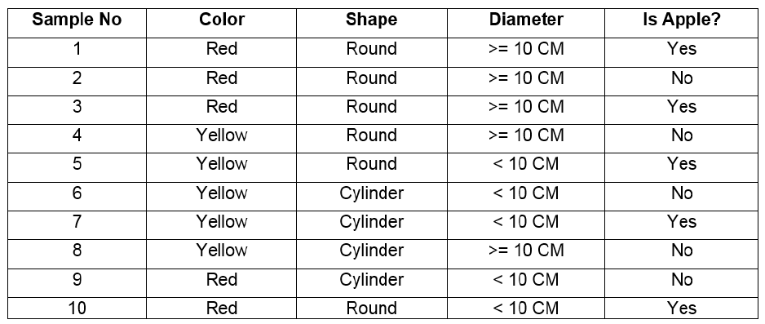
Example

Slide 50
Example
Imagine that you have the data set that is shown in the previous table. The column with title “Is Apple?” represents the label of the data. Our objective is to make a new prediction for a new observation.
The new observation has the following features:
Color: Red
Shape: Round
Diameter: 10 cm

Slide 51


Naïve Bayes Classification
If
$$P(X|Yes)×P(Yes)$$
>
$$P(X|No)×P(No)$$
Then class yes, otherwise class No

Slide 52
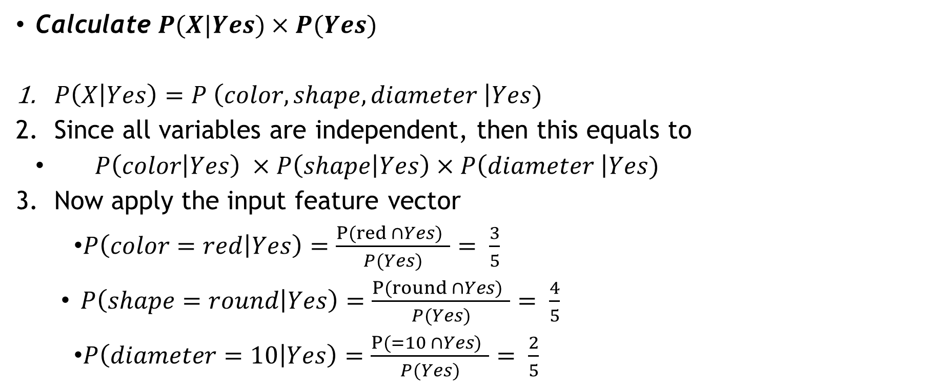
Example
This can be calculated from the dataset
Calculate $P(X|Yes)×P(Yes)$
$P\left(X | Yes\right)=P \left(color, shape, diameter \right|Yes)$
Since all variables are independent, then this equals to
$P\left(color | Yes\right) ×P\left(shape | Yes\right)×P\left(diameter \right|Yes)$
Now apply the input feature vector
$P\left(color=red | Yes\right)=\frac{P(red ∩Yes) }{P(Yes)}= \frac{3}{5}$
$P\left(shape=round | Yes\right)=\frac{P(round ∩Yes) }{P(Yes)}= \frac{4}{5}$
$P\left(diameter=10 | Yes\right)=\frac{P(=10 ∩Yes) }{P(Yes)}= \frac{2}{5}$

Slide 53



$$P\left(color=red | Yes\right)$$
$$P\left(shape=round | Yes\right)$$
$$P\left(diameter=10 | Yes\right)$$

Slide 54
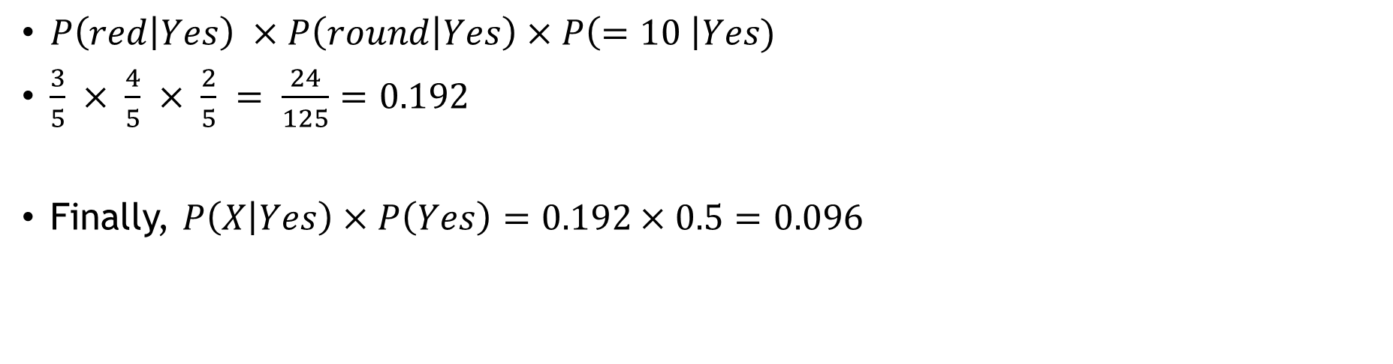
Example
$P\left(red | Yes\right) ×P\left(round | Yes\right)×P\left(=10 \right|Yes)$
$\frac{3}{5} × \frac{4}{5} × \frac{2}{5} = \frac{24}{125}=0.192$
Finally, $P\left(X | Yes\right)×P\left(Yes\right)=0.192×0.5=0.096$

Slide 55
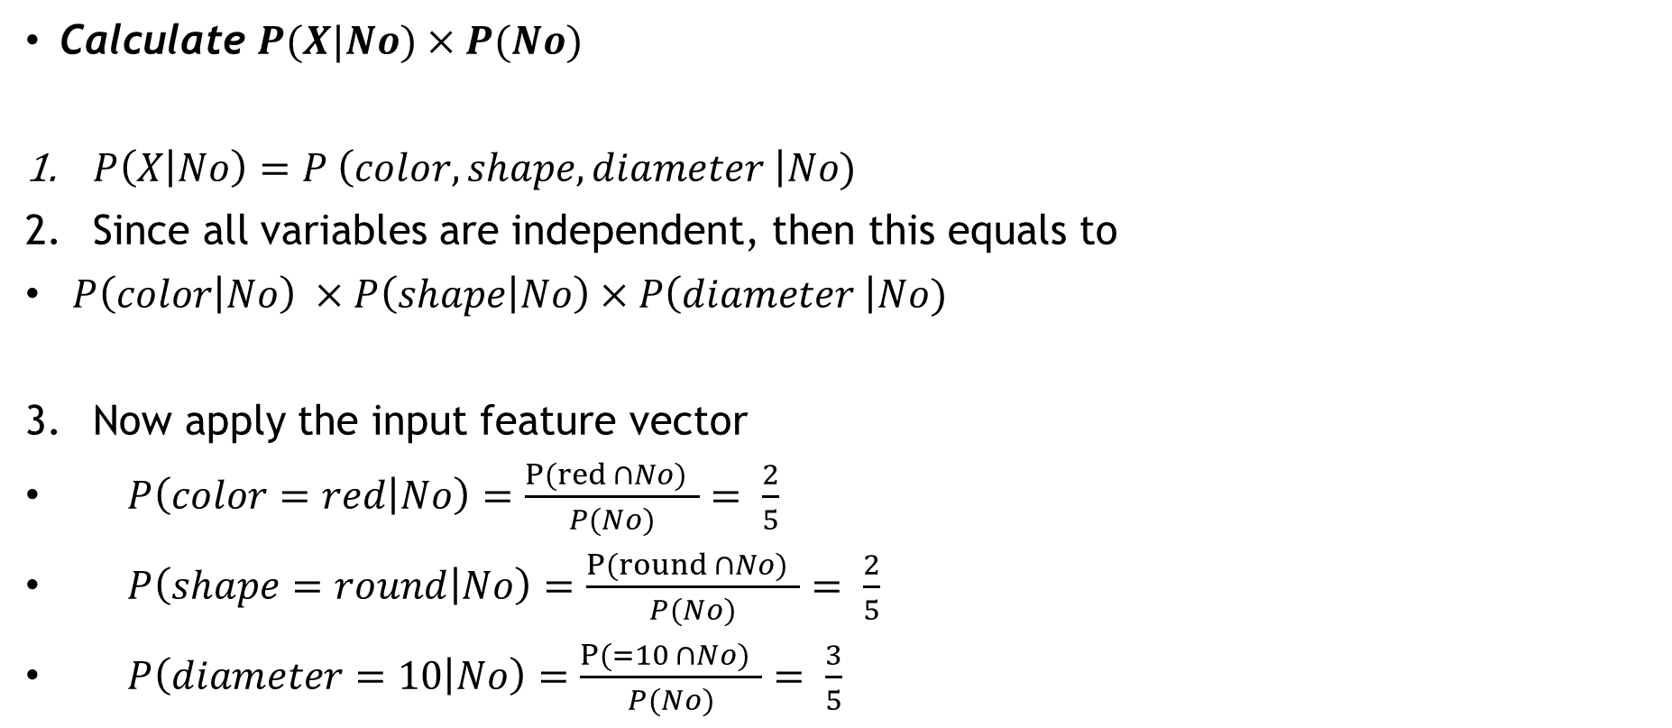
Example
Calculate $P(X|No)×P(No)$
$P\left(X | No\right)=P \left(color, shape, diameter \right|No)$
Since all variables are independent, then this equals to
$P\left(color | No\right) ×P\left(shape | No\right)×P\left(diameter \right|No)$
Now apply the input feature vector
$P\left(color=red | No\right)=\frac{P(red ∩No) }{P(No)}= \frac{2}{5}$
$P\left(shape=round | No\right)=\frac{P(round ∩No) }{P(No)}= \frac{2}{5}$
$P\left(diameter=10 | No\right)=\frac{P(=10 ∩No) }{P(No)}= \frac{3}{5}$

Slide 56
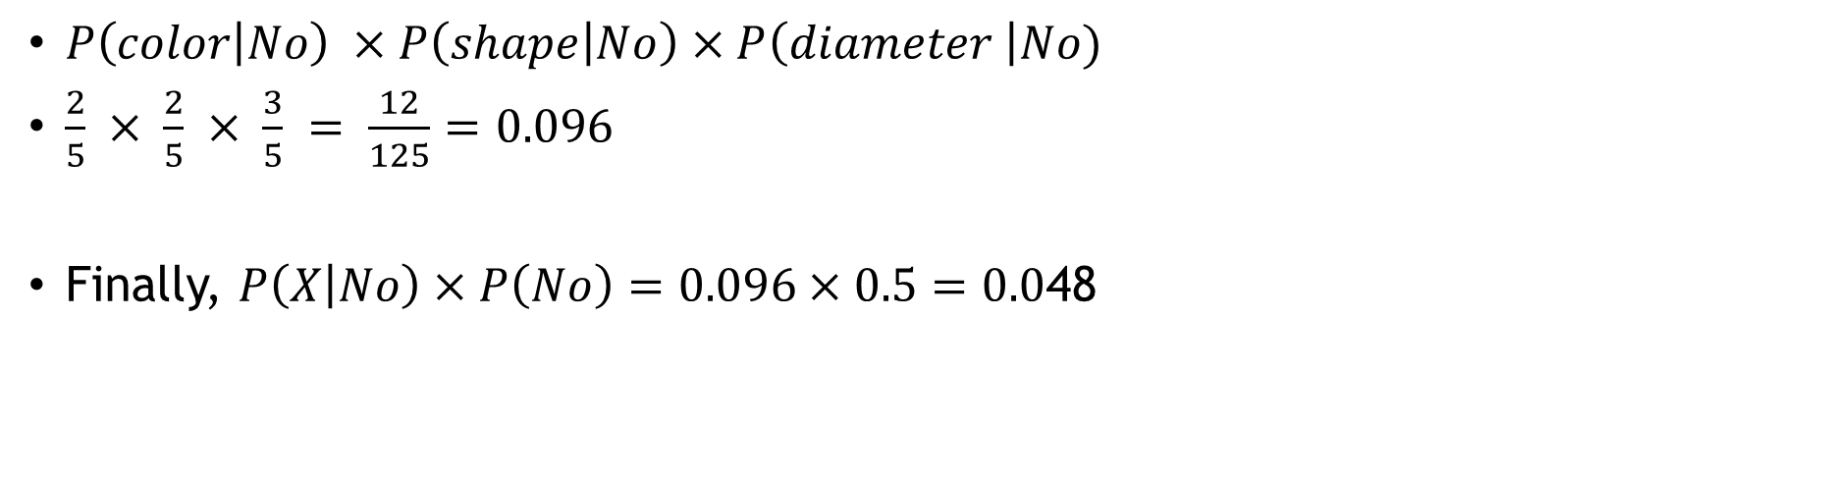
Example
$P\left(color | No\right) ×P\left(shape | No\right)×P\left(diameter \right|No)$
$\frac{2}{5} × \frac{2}{5} × \frac{3}{5} = \frac{12}{125}=0.096$
Finally, $P\left(X | No\right)×P\left(No\right)=0.096×0.5=0.0$48

Slide 57
Example
$$P(X|Yes)×P(Yes)$$
>
$$P(X|No)×P(No)$$
0.096
>
0.048
Thus, the class for this observation is yes Apple,

Slide 58
In this lesson … Part 2
Python Lab

